Slide 1
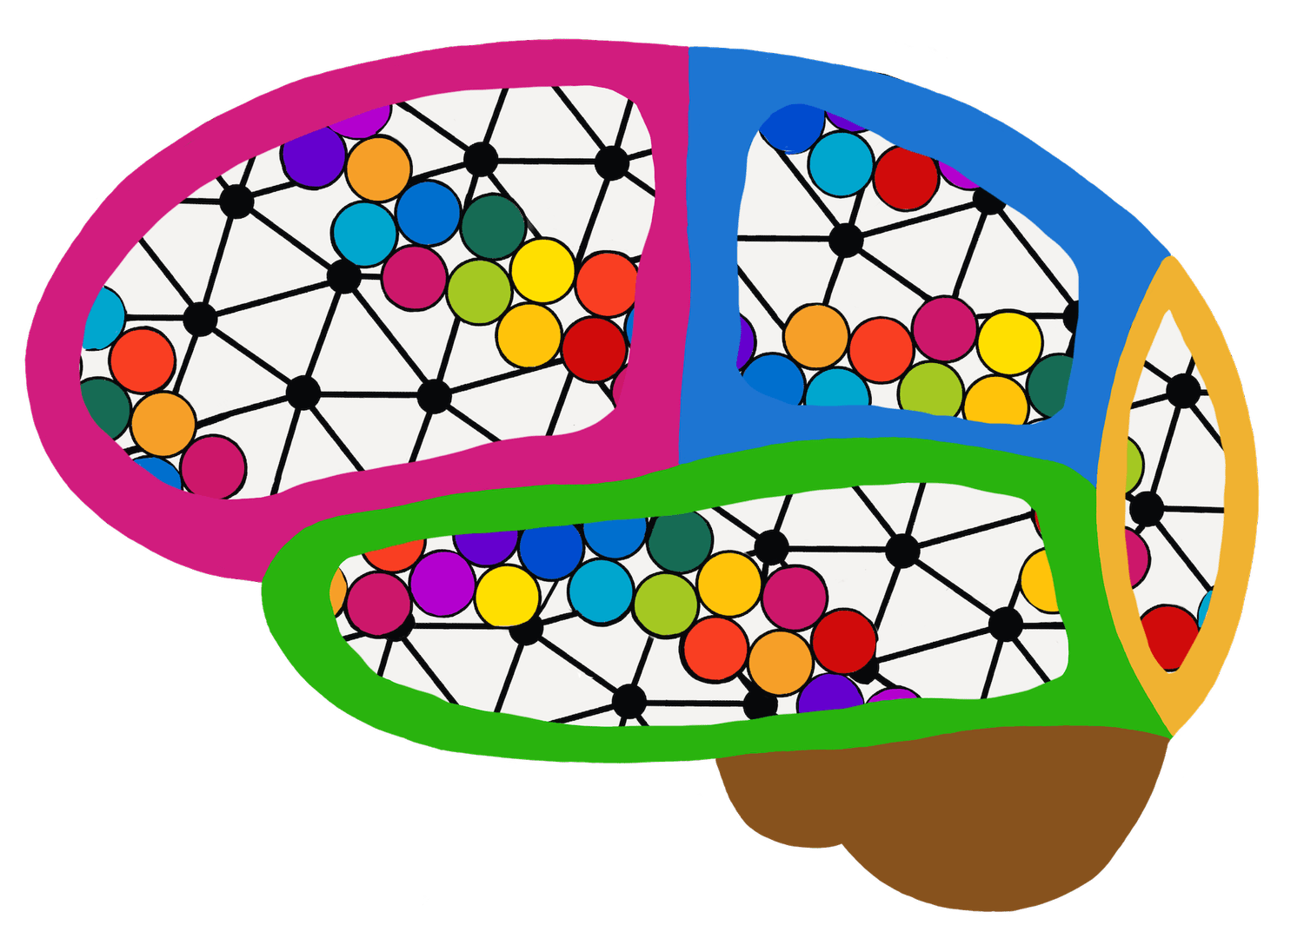
Neural Language Models
Week 6
CSY3055 – Natural Language Processing
Dr Oluseyi Oyedeji

Slide 2
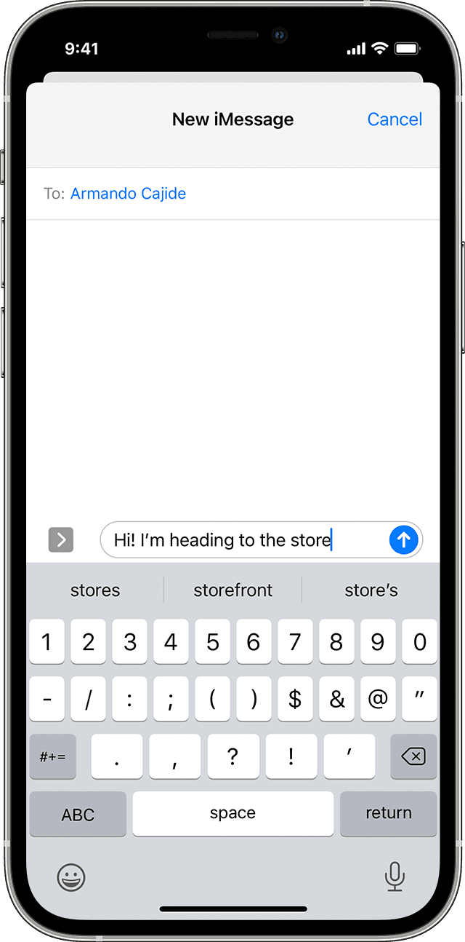

When your phone finishes your sentences, or when ChatGPT writes a paragraph that makes sense. how does it know what word comes next?
This lecture explores how RNNs, LSTMs, and GRUs handle sequences and generate text
Notes:
This lecture builds the bridge from last week’s embeddings to deep sequential models — how computers remember context in language.

Slide 3
Learning Goals for Week 6
By the end of week six, you should be able to:
Explain how neural networks can model language sequences.
Describe the architecture of Recurrent Neural Networks (RNNs).
Understand vanishing and exploding gradients.
Explain how Long Short-Term Memory (LSTM) networks address these issues.
Understand how text generation works using RNN-based models.

Slide 4
Why Study Neural Language Models?
Language models underpin:
Predictive text and autocorrect.
Speech recognition.
Grammar and style correction.
Machine translation.
Chatbots and generative text (like GPT).
Notes:
Every time your phone guesses the next word, that’s a neural language model at work.

Slide 5
From Traditional to Neural LMs
Traditional n-gram models:
Count word co-occurrences.
Limited by fixed window size.
Neural models
Learn distributed representations.
Capture longer dependencies.
Generalise to unseen contexts.
Notes:
Neural models solve the “combinatorial explosion” of n-grams by learning meaning in continuous space.

Slide 6
Today’s Session
Introduction
Neural Networks
Recurrent Neural Network (RNN)
Long Short-Term Memory
Gated Recurrent Unit (GRU)
Practical Session

Slide 7
FEEDFORWARD NEURAL NETWORKS

Slide 8
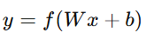
What is Neural Network?
A neural network is a type of machine learning model designed to recognize patterns and make decisions in a way that loosely mimics how the human brain works.
Consists of layers of “neurons” that transform input signals.
Learns patterns from data via weight adjustments.

Slide 9
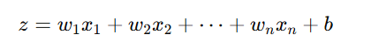
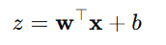
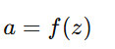
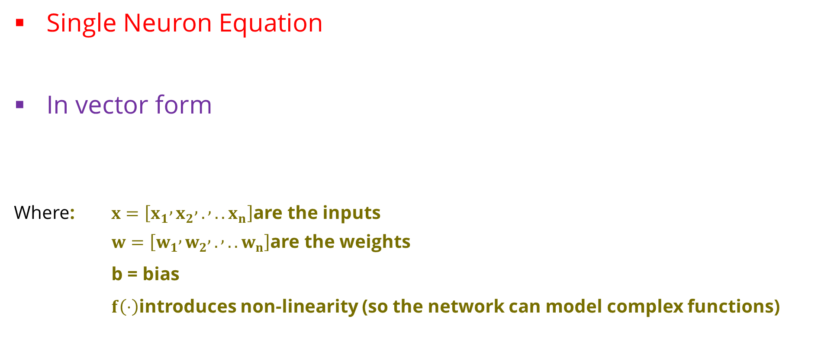
Basic Structure of Neural Networks
Single Neuron Equation
In vector form
Where: $x=\left[x_{1} , x_{2} , . , ..x_{n}\right]$are the inputs
$w=\left[w_{1} , w_{2} , . , ..w_{n}\right]$are the weights
b = bias
$f\left(⋅\right)$introduces non-linearity (so the network can model complex functions)

Slide 10
Basic Structure of Neural Networks
Layer | Purpose
Input layer | Takes in the raw data (e.g., pixels from an image, words from text, numbers from a dataset).
Hidden layers | Perform mathematical transformations to extract patterns or relationships in the data.
Output layer | Produces the final prediction or classification (e.g., “cat” vs “dog,” or a numerical value).
Each connection between neurons has a weight, and each neuron has a bias. Together they determine how much influence one neuron’s output has on another.

Slide 11
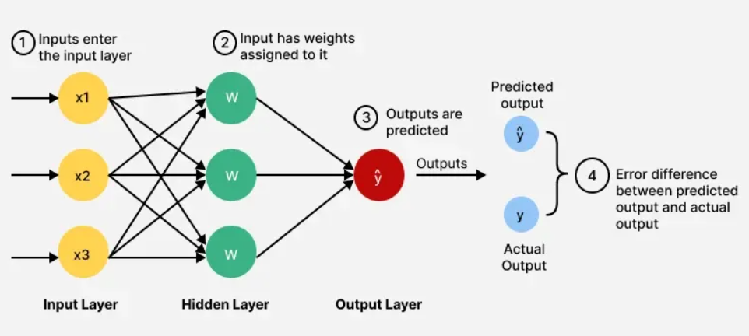
Structure of Neural Networks
basic feedforward diagram — input → hidden → output
Notes:
This is the foundation. Each layer detects higher-level abstractions — from words to concepts

Slide 12
How the Network Learns
Each weight starts as a small random number.
We show the model examples and measure how wrong it is using a loss function (often cross-entropy loss).
Then we update weights using backpropagation, a clever use of the chain rule from calculus.
Forward pass → make a prediction
Compare to correct answer → compute loss
Backward pass → adjust weights slightly
After thousands of small corrections, the network “figures out” good weights.

Slide 13
Limitations of Feedforward Networks
Feed-forward networks see each input separately, they forget what came before.
But language is sequential
Feedforward networks:
Handle fixed-size inputs only.
Forget previous inputs , no memory.
Poor for sequential data (text, audio, etc.).
“I bought a loaf of ___” → depends on previous words
Even Word2Vec is only able to create word similarities, there is no contextual memory
Notes:
Human language depends on order. “He unlocked the door with the ___” — we can’t predict the last word without memory.

Slide 14
RECURRENT NEURAL NETWORKS (RNNs)

Slide 15
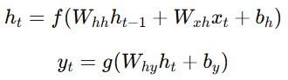
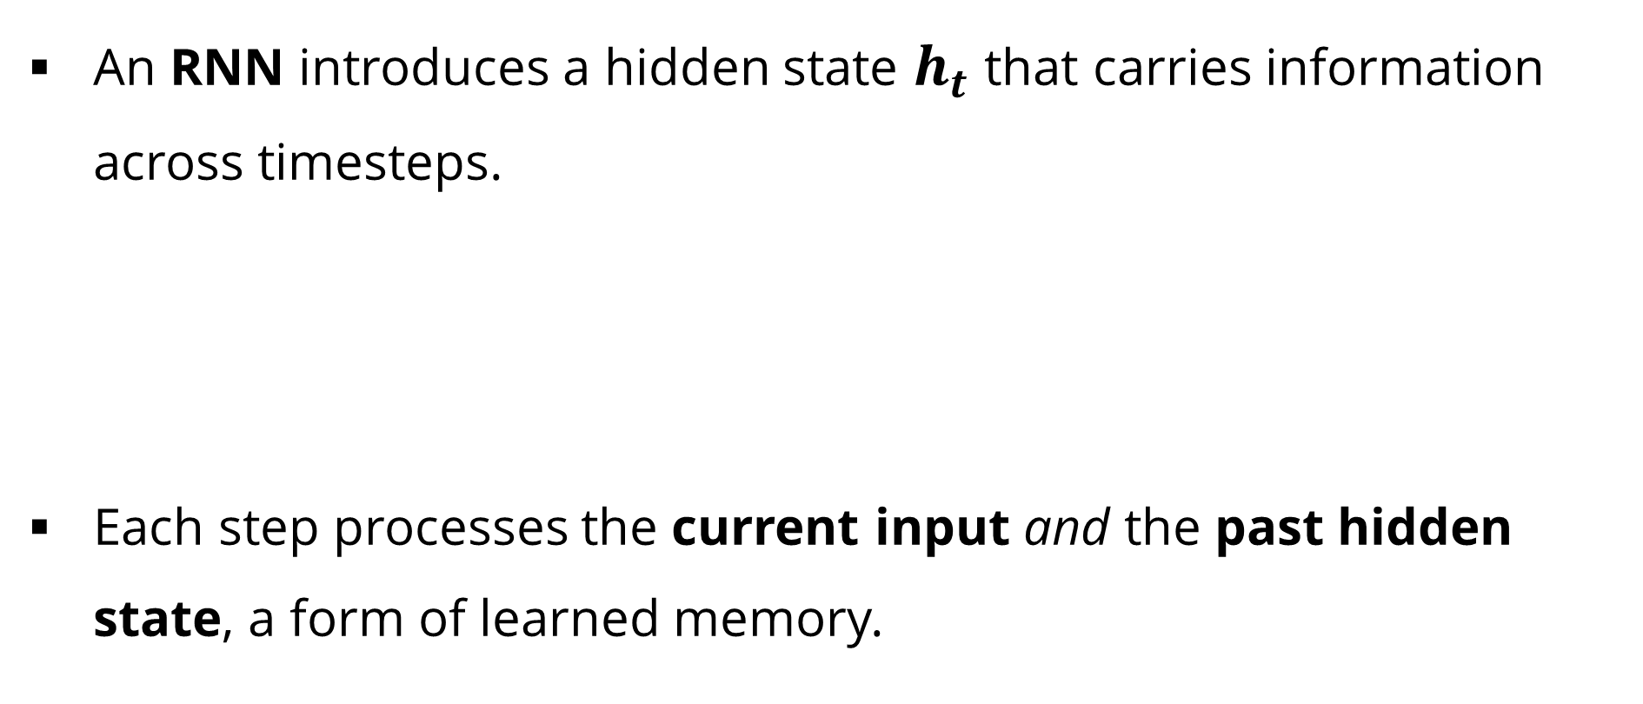
Intuition: Adding Memory
An RNN introduces a hidden state $h_{t}$ that carries information across timesteps.
Each step processes the current input and the past hidden state, a form of learned memory.
Notes:
Human language depends on order. “He unlocked the door with the ___” — we can’t predict the last word without memory.

Slide 16
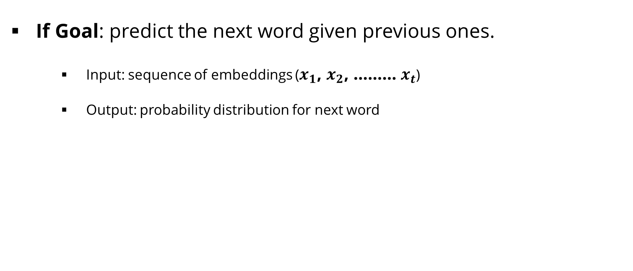
Simple RNN Language Model
If Goal: predict the next word given previous ones.
Input: sequence of embeddings ($x_{1}$, $x_{2}$, ……… $x_{t}$)
Output: probability distribution for next word
Notes:
Unlike n-grams, RNNs use continuous representations — meaning carries over smoothly.

Slide 17
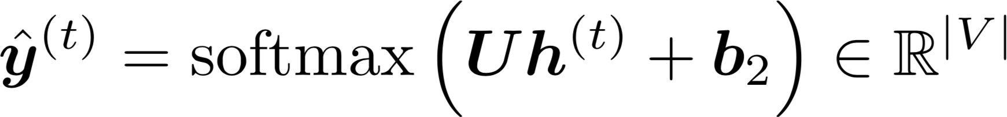

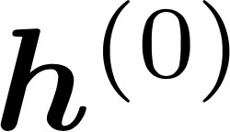
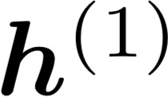
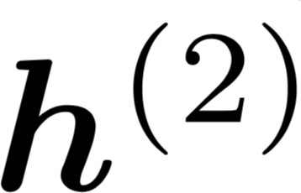
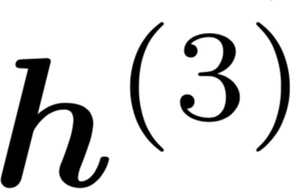
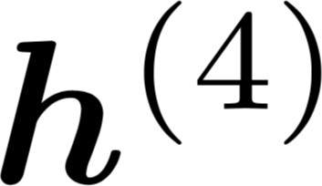



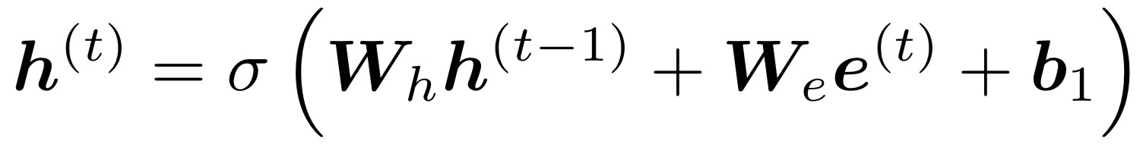
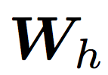






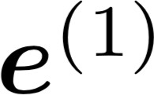
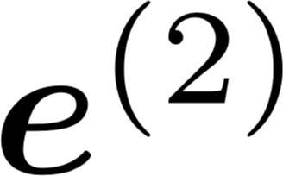
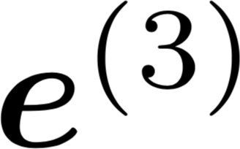
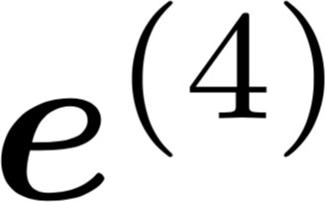
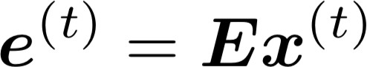

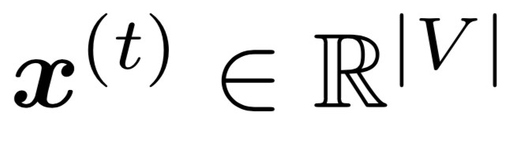
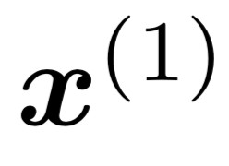
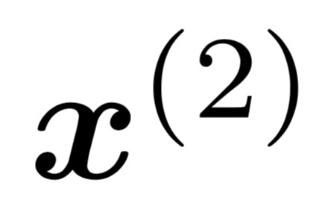
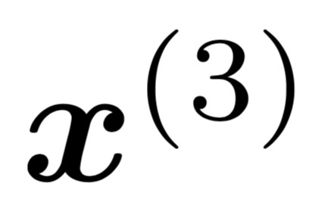
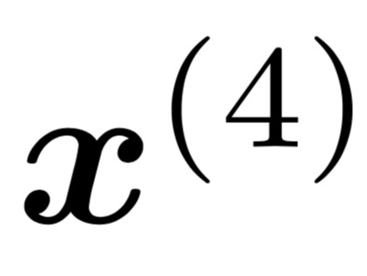
The Simple RNN Language Model
books
laptops
output distribution
a
zoo
hidden states
is the initial hidden state
word embeddings
words / one-hot vectors
the students
opened
their
Note: this input sequence could be much longer now!
Notes:
Unlike n-grams, RNNs use continuous representations — meaning carries over smoothly.

Slide 18
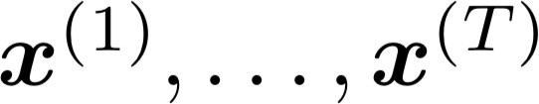
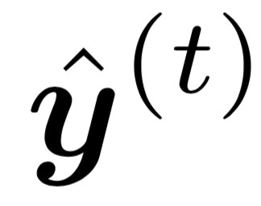
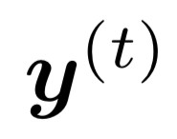
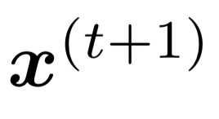
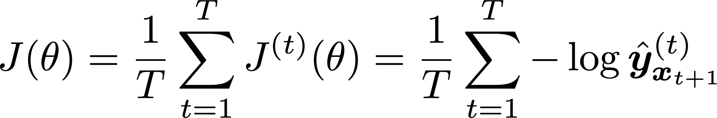
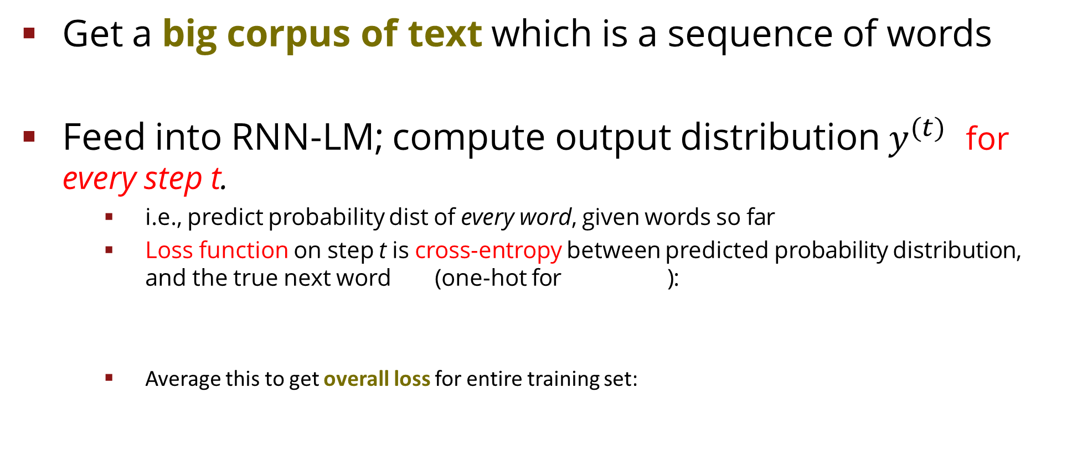
Training an RNN Language Model
Get a big corpus of text which is a sequence of words
Feed into RNN-LM; compute output distribution $y^{(t)}$ for every step t.
i.e., predict probability dist of every word, given words so far
Loss function on step t is cross-entropy between predicted probability distribution , and the true next word (one-hot for ):
Average this to get overall loss for entire training set:

Slide 19
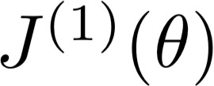
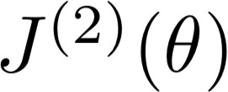
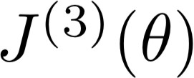
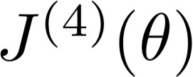
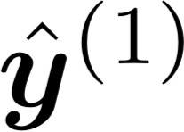
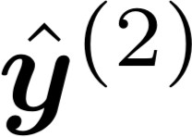
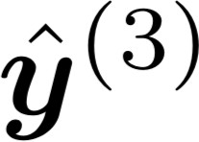
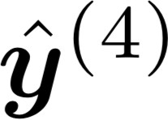



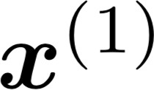
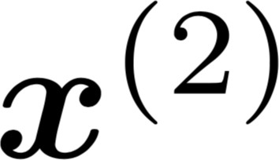
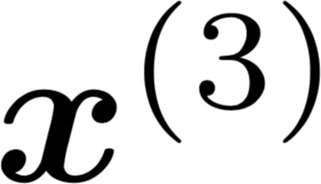
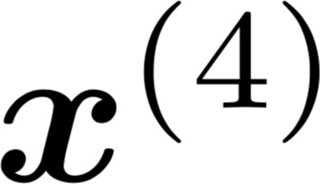
Training an RNN Language Model
= negative log prob of “students”
Loss
Predicted prob dists
…
Corpus
the
students
opened
their
exams
…

Slide 20
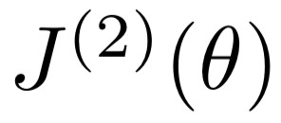
Training an RNN Language Model
= negative log prob of “opened”
Loss
Predicted prob dists
…
Corpus
the
students
opened
their
exams
…

Slide 21
Training an RNN Language Model
= negative log prob of “their”
Loss
Predicted prob dists
…
Corpus
the
students
opened
their
exams
…

Slide 22
Training an RNN Language Model
= negative log prob of “exams”
Loss
Predicted prob dists
…
Corpus
the
students
opened
their
exams
…

Slide 23
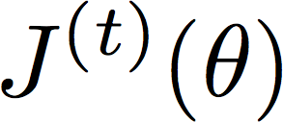
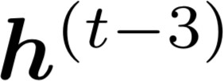






Backpropagation for RNNs
BPTT is just backprop across multiple timesteps, we reuse the same weights, so gradients accumulate. [Backpropagation through time]
…
…
Answer: Backpropagate over timesteps
i=t,…,0, summing gradients as you go.
This algorithm is called “backpropagation through time” [Werbos, P.G., 1988, Neural Networks 1, and others]
Question: How do we calculate this?

Slide 24
Teacher Forcing
During training, feed the true previous word (not the model’s prediction)
Speeds convergence and stabilises learning.
Notes:
It’s like giving the model the correct answer as context until it learns to stand on its own.

Slide 25

Teacher Forcing
“Teacher forcing”
Loss
+
+
+
+ … =
Predicted prob dists
…
Corpus
the
students
opened
their
exams
…

Slide 26
GRADIENT CHALLENGES

Slide 27

The BPTT Problem
Back propagation through time (BPTT) occurs in RNN
In long sequences
Gradients can vanish (model forgets earlier context).
Or explode (unstable learning).

Slide 28


Vanishing Gradient (Concept)
Each timestep multiplies gradients by $W_{h}$ repeatedly:
If eigenvalues of $W_{h}<1$, gradients shrink exponentially, Gradient vanishes
Earlier signals vanish; the network “forgets” distant words like the subject of a long sentence.

Slide 29






Vanishing gradient intuition
Vanishing gradient problem: When these are small, the gradient signal gets smaller and smaller as it backpropagates further
What happens if these are small?

Slide 30
Why is vanishing gradient a problem?
Gradient signal from far away is lost because it’s much smaller than gradient signal from close-by.
So, model weights are updated only with respect to near effects, not long-term effects.

Slide 31
Effect of vanishing gradient on RNN-LM
LM task: When she tried to print her tickets, she found that the printer was out of toner. She went to the stationery store to buy more toner. It was very overpriced. After installing the toner into the printer, she finally printed her
To learn from this training example, the RNN-LM needs to model the dependency between “tickets” on the 7th step and the target word “tickets” at the end.
But if gradient is small, the model can’t learn this dependency
So, the model is unable to predict similar long-distance dependencies at test time

Slide 32

Exploding Gradient (Concept)
If eigenvalues of $W_{h}>1$, gradients grow exponentially.
Weight updates become huge.
Training diverges.

Slide 33

Why is exploding gradient a problem?
If the gradient becomes too big, then the SGD update step becomes too big:
learning rate
gradient
This can cause bad updates: we take too large a step and reach a weird and bad parameter configuration (with large loss)
You think you’ve found a hill to climb, but suddenly you’re in a different country
In the worst case, this will result in Inf or NaN in your network (then you have to restart training from an earlier checkpoint)

Slide 34

How to fix the vanishing gradient problem?
The main problem is that it’s too difficult for the RNN to learn to preserve information over many timesteps.
In a vanilla RNN, the hidden state is constantly being rewritten
How about a RNN with separate memory?

Slide 35
LONG SHORT-TERM MEMORY (LSTM)

Slide 36




Long Short-Term Memory RNNs (LSTMs)
A type of RNN proposed by Hochreiter and Schmidhuber in 1997 as a solution to the vanishing gradients problem.
Everyone cites that paper but really a crucial part of the modern LSTM is from Gers et al. (2000)
On step t, there is a hidden state and a cell state
Both are vectors length n
The cell stores long-term information
The LSTM can read, erase, and write information from the cell
The cell becomes conceptually rather like RAM in a computer
The selection of which information is erased/written/read is controlled by three corresponding gates
The gates are also vectors length n
On each timestep, each element of the gates can be open (1), closed (0), or somewhere in-between
The gates are dynamic: their value is computed based on the current context
“Long short-term memory”, Hochreiter and Schmidhuber, 1997. https://www.bioinf.jku.at/publications/older/2604.pdf “Learning to Forget: Continual Prediction with LSTM”, Gers, Schmidhuber, and Cummins, 2000. https://dl.acm.org/doi/10.1162/089976600300015015

Slide 37


Long Short-Term Memory (LSTM)
We have a sequence of inputs 𝑥^{(")}, and we will compute a sequence of hidden states ℎ^{(")} and cell states
𝑐^{(")}. On timestep t:
Sigmoid function: all gate values are between 0 and 1
Forget gate: controls what is kept vs forgotten, from previous cell state
Input gate: controls what parts of the new cell content are written to cell
All these are vectors of same length n
Output gate: controls what parts of cell are output to hidden state
New cell content: this is the new content to be written to the cell
Cell state: erase (“forget”) some content from last cell state, and write (“input”) some new cell content
Hidden state: read (“output”) some content from the cell
Gates are applied using element-wise (or Hadamard) product: ⊙

Slide 38


Long Short-Term Memory (LSTM)
You can think of the LSTM equations visually like this:
Source: http://colah.github.io/posts/2015-08-Understanding-LSTMs/

Slide 39

Long Short-Term Memory (LSTM)
You can think of the LSTM equations visually like this:
Write some new cell content
The + sign is the secret!
Forget some cell content
c_{t}
c
ct-1
t
f
i_{t}
o_{t}
Output some cell content to the hidden state
Compute the forget gate
t
_{c}~
t
ht-1
h_{t}
Compute the input gate
Compute the new cell content
Compute the output gate
Source: http://colah.github.io/posts/2015-08-Understanding-LSTMs/

Slide 40
Why LSTMs Work
Additive cell state enables stable gradient flow.
Gates control what’s remembered or forgotten.
Learn long-term dependencies (100+ timesteps).
Notes:
Additive cell state enables stable gradient flow.
Gates control what’s remembered or forgotten.
Learn long-term dependencies (100+ timesteps).

Slide 41
LSTMs: real-world success
In 2013–2015, LSTMs started achieving state-of-the-art results
Successful tasks include handwriting recognition, speech recognition, machine translation, parsing, and image captioning, as well as language models
LSTMs became the dominant approach for most NLP tasks
Now (2021-2025), other approaches (e.g., Transformers) have become dominant for many tasks
For example, in WMT (a Machine Translation conference + competition):
In WMT 2016, the summary report contains “RNN” 44 times
In WMT 2019: “RNN” 7 times, ”Transformer” 105 times
Source: "Findings of the 2016 Conference on Machine Translation (WMT16)", Bojar et al. 2016, http://www.statmt.org/wmt16/pdf/W16-2301.pdf Source: "Findings of the 2018 Conference on Machine Translation (WMT18)", Bojar et al. 2018, http://www.statmt.org/wmt18/pdf/WMT028.pdf Source: "Findings of the 2019Conference on Machine Translation (WMT19)", Barrault et al. 2019, http://www.statmt.org/wmt18/pdf/WMT028.pdf
Notes:
Additive cell state enables stable gradient flow.
Gates control what’s remembered or forgotten.
Learn long-term dependencies (100+ timesteps).

Slide 42
GRU Overview
Gated Recurrent Unit (Cho et al., 2014)
Simpler alternative to LSTM
Combines forget & input gates [update gate].
Merges cell and hidden states.
Fewer parameters [faster training]
Notes:
GRUs are leaner , they often perform equally well with smaller datasets.

Slide 43
LSTM vs GRU Summary
Feature | LSTM | GRU
Gates | 3 | 2
Memory cell | Yes | No (merged)
Complexity | Higher | Lower
Best for | Long sequences | Smaller datasets

Slide 44


Generating text with an RNN Language Model
Let’s have some fun!
You can train an RNN-LM on any kind of text, then generate text in that style.
RNN-LM trained on Harry Potter:
Source: https://medium.com/deep-writing/harry-potter-written-by-artificial-intelligence-8a9431803da6

Slide 45

Generating a TV show Episode with LSTM
Let’s have some fun!
You can train an LSTM on any kind of text, then generate text in that style.
LSTM trained on tv series script:
Source: https://medium.com/deep-writing/silicon-valley-a-new-episode-written-by-ai-a8f832645bc2

Slide 46
Ethical Reflection
Neural LMs can
Memorise sensitive data from training sets.
Reflect or amplify social bias.
Generate plausible but false text.
Best practice
Use differential privacy, filtered datasets, and bias audits.

Slide 47
Summary
Neural LMs predict the next token in context.
RNNs capture sequential memory.
LSTMs and GRUs solve gradient problems.
Gradient clipping and gating = stable learning.
Ethical AI = mindful data and deployment.

Slide 48
Practical & Wrap-Up

Slide 49
Thank you

